Slide 1
OnlineShopDVDS
Group II - C1007I – Sem IV

Slide 2
FPT APTECH CENTER I
Develop by
Phung Van Thuc(Leader)
Vu Hoang Chien
Dinh Ngoc Hung
Teacher Introduction: LE THI HAO

Slide 3
Content
Project Introduction
Functions of program
DB Diagram

Slide 4
Project Introduction
Project name: Online Shop DVDS
System is developed on Net Bean 7.1.2 environment
This Web is common in each Store and member to buy and sells DVDS.
Develop language : Java
Developments tools : Net Bean 7.1.2, SQL Server 2008

Slide 5
Project Introduction
Music, Game, Movie is an important part of our life. Nowadays, listening to music online is hobby of most modern people. So you need to build website where users will get relevant information about the latest music, game, movie releases in the market.
This website has web pages that give information about the new releases in the field of music, game, and movie in the National market.

Slide 6
Function of program
  Register account
  Login
  Manage album
  Manage card
  Order
  Playing Music and watch trailer movies and trailer game

Slide 7
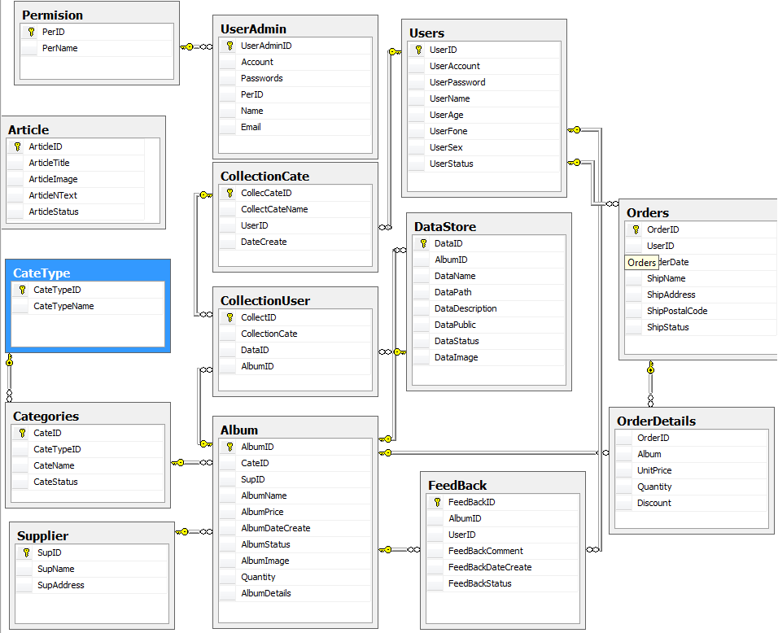
DB Diagram

Slide 8
OnlineShopDVDS by Group II
Thank You !

